Slide 1
Watchmode API

Slide 2
Topic
Use API of different streaming services
use to search for the popular movies & shows with relevant information include but not limited ‘sources link,actors,directors, release year, genre...’
searching might involved with external ID (IMDB,TMDB)..
...also append other APIs to make it more complete
Filter: as a chosen date change, info could update in sync

Slide 3
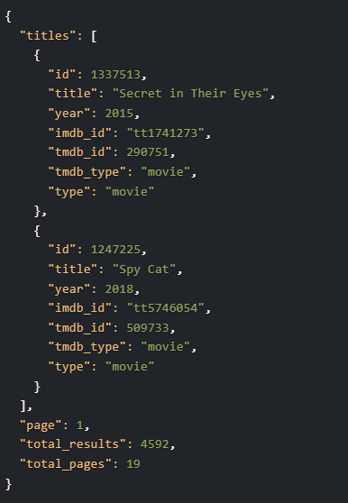
Available data - List of movies

Slide 4
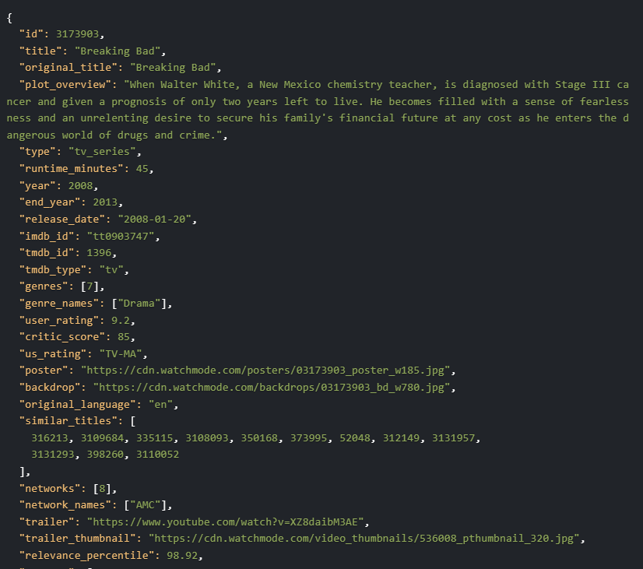
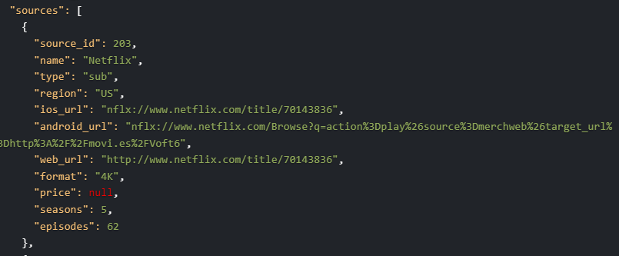
Available data – Per title

Slide 5
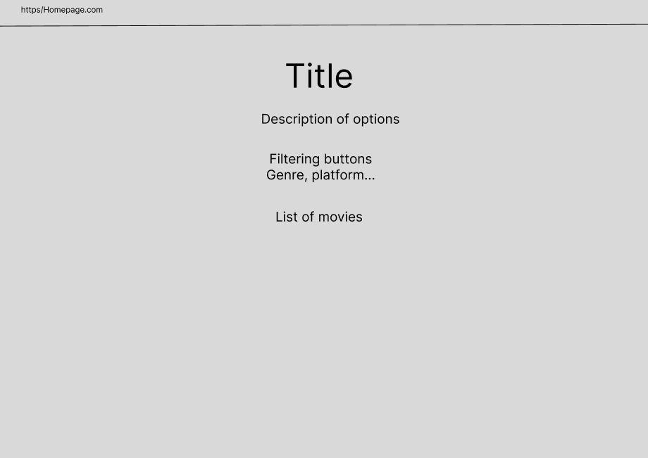
Homepage

Slide 6
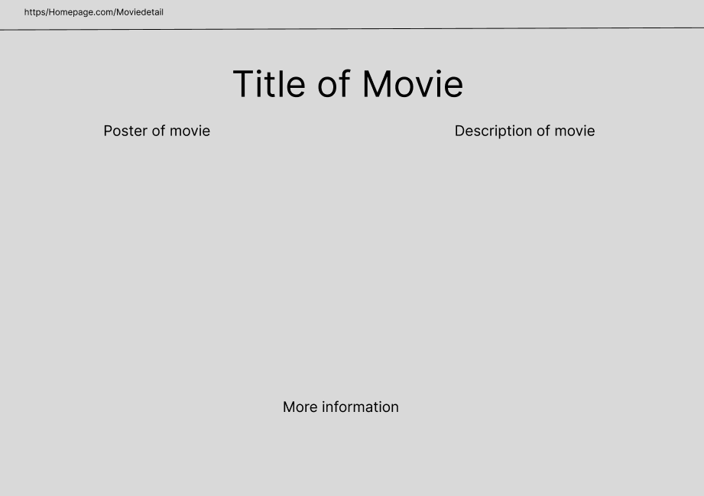
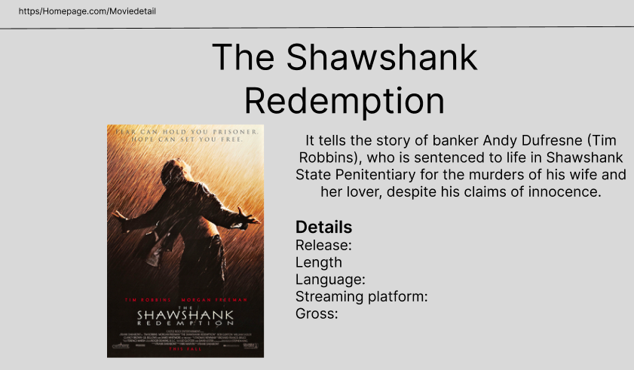
Specific movie

